Slide 1
COMP 918: Research Administration for Scientists
Human Subject Testing: History, Recent Cases, Informed Consent and Institutional Review Boards
Tim Quigg, Lecturer and Associate Chair for Administration, Finance and Entrepreneurship Computer Science Department, UNC-Chapel Hill
© Copyright 2013 Timothy L. Quigg All Rights Reserved

Slide 2
In one sense, our contemporary approach to the protection of human subjects in research is a reaction to the horrific crimes committed in the guise of scientific research by the Nazis during the Holocaust!
“Laws are often written in response to some terrible crime!”

Slide 3
The Holocaust and the Nuremberg Trials
Millions of Jewish people, gypsies, gay people, Polish Catholic priests, Russian nationals, the mentally ill and political dissidents were victimized by the Nazis by being subjected to atrocious medical experiments as was thoroughly documented at the 1946 Nuremberg Trials (The Doctor’s Trial).

Slide 4
The Holocaust and the Nuremberg Trials
The crimes committed by licensed physicians are well-documented and include experiments in:
Freezing
Malaria
Sea water
Mustard gas
Twin tests
Sterilization
High altitude/low pressure

Slide 5
The Holocaust and the Nuremberg Trials
“Obviously all of these experiments involving brutalities, tortures, disabling injury, and death were performed in complete disregard of international conventions, the laws and customs of war, the general principles of criminal law as derived from the criminal laws of all civilized nations, and Control Council Law No. 10. Manifestly human experiments under such conditions are contrary to “the principles of the law of nations as they result from the usages established among civilized peoples, from the laws of humanity and from the dictates of public conscience.”
Nuremberg Proceedings

Slide 6
The Holocaust and the Nuremberg Trials
“Obviously all of these experiments involving brutalities, tortures, disabling injury, and death were performed in complete disregard of international conventions, the laws and customs of war, the general principles of criminal law as derived from the criminal laws of all civilized nations, and Control Council Law No. 10. Manifestly human experiments under such conditions are contrary to “the principles of the law of nations as they result from the usages established among civilized peoples, from the laws of humanity and from the dictates of public conscience.”
Nuremberg Proceedings

Slide 7
The Holocaust and the Nuremberg Trials
How could these atrocities have been committed by Doctors?
Human exploitation is easier when bigotry (often culturally sanctioned) leads one to view the subject as “less than human.”

Slide 8
Permissible Medical Experiments
What is permissible? What “principles of the law of nations” are applicable?”
The Nuremberg Code is an attempt to answer these questions!

Slide 9
THE NUREMBERG CODE [from Trials of War Criminals before the Nuremberg Military Tribunals under Control Council Law No. 10. Nuremberg, October 1946–April 1949. Washington, D.C.: U.S.G.P.O, 1949–1953.]
Permissible Medical Experiments
The great weight of the evidence before us is to the effect that certain types of medical experiments on human beings, when kept within reasonably well-defined bounds, conform to the ethics of the medical profession generally. The protagonists of the practice of human experimentation justify their views on the basis that such experiments yield results for the good of society that are unprocurable by other methods or means of study. All agree, however, that certain basic principles must be observed in order to satisfy moral, ethical and legal concepts:

Slide 10
THE NUREMBERG CODE [from Trials of War Criminals before the Nuremberg Military Tribunals under Control Council Law No. 10. Nuremberg, October 1946–April 1949. Washington, D.C.: U.S.G.P.O, 1949–1953.]
Permissible Medical Experiments
The great weight of the evidence before us is to the effect that certain types of medical experiments on human beings, when kept within reasonably well-defined bounds, conform to the ethics of the medical profession generally. The protagonists of the practice of human experimentation justify their views on the basis that such experiments yield results for the good of society that are unprocurable by other methods or means of study. All agree, however, that certain basic principles must be observed in order to satisfy moral, ethical and legal concepts:

Slide 11
THE NUREMBERG CODE [from Trials of War Criminals before the Nuremberg Military Tribunals under Control Council Law No. 10. Nuremberg, October 1946–April 1949. Washington, D.C.: U.S.G.P.O, 1949–1953.]
Permissible Medical Experiments
The great weight of the evidence before us is to the effect that certain types of medical experiments on human beings, when kept within reasonably well-defined bounds, conform to the ethics of the medical profession generally. The protagonists of the practice of human experimentation justify their views on the basis that such experiments yield results for the good of society that are unprocurable by other methods or means of study. All agree, however, that certain basic principles must be observed in order to satisfy moral, ethical and legal concepts:

Slide 12
THE NUREMBERG CODE [from Trials of War Criminals before the Nuremberg Military Tribunals under Control Council Law No. 10. Nuremberg, October 1946–April 1949. Washington, D.C.: U.S.G.P.O, 1949–1953.]
Permissible Medical Experiments
The great weight of the evidence before us is to the effect that certain types of medical experiments on human beings, when kept within reasonably well-defined bounds, conform to the ethics of the medical profession generally. The protagonists of the practice of human experimentation justify their views on the basis that such experiments yield results for the good of society that are unprocurable by other methods or means of study. All agree, however, that certain basic principles must be observed in order to satisfy moral, ethical and legal concepts:

Slide 13
THE NUREMBERG CODE [from Trials of War Criminals before the Nuremberg Military Tribunals under Control Council Law No. 10. Nuremberg, October 1946–April 1949. Washington, D.C.: U.S.G.P.O, 1949–1953.]
Permissible Medical Experiments
The great weight of the evidence before us is to the effect that certain types of medical experiments on human beings, when kept within reasonably well-defined bounds, conform to the ethics of the medical profession generally. The protagonists of the practice of human experimentation justify their views on the basis that such experiments yield results for the good of society that are unprocurable by other methods or means of study. All agree, however, that certain basic principles must be observed in order to satisfy moral, ethical and legal concepts:

Slide 14
Permissible Medical Experiments
The beginning of a definition:
reasonably well-defined bounds
conform to the ethics of the medical profession
yield results for the good of society
these results are unprocurable by other
methods or means of study
Is this enough? Anything missing?

Slide 15
THE NUREMBERG CODE [from Trials of War Criminals before the Nuremberg Military Tribunals under Control Council Law No. 10. Nuremberg, October 1946–April 1949. Washington, D.C.: U.S.G.P.O, 1949–1953.]
The voluntary informed consent of the human subject is absolutely essential.
This means that the person involved should have legal capacity to give consent; should be so situated as to be able to exercise free power of choice, without the intervention of any element of force, fraud, deceit, duress, over-reaching, or other ulterior form of constraint or coercion; and should have sufficient knowledge and comprehension of the elements of the subject matter involved as to enable him to make an understanding and enlightened decision. This latter element requires that before the acceptance of an affirmative decision by the experimental subject there should be made known to him the nature, duration, and purpose of the experiment; the method and means by which it is to be conducted; all inconveniences and hazards reasonably to be expected; and the effects upon his health or person which may possibly come from his participation in the experiment.

Slide 16
THE NUREMBERG CODE [from Trials of War Criminals before the Nuremberg Military Tribunals under Control Council Law No. 10. Nuremberg, October 1946–April 1949. Washington, D.C.: U.S.G.P.O, 1949–1953.]
The voluntary informed consent of the human subject is absolutely essential.
This means that the person involved should have legal capacity to give consent; should be so situated as to be able to exercise free power of choice, without the intervention of any element of force, fraud, deceit, duress, over-reaching, or other ulterior form of constraint or coercion; and should have sufficient knowledge and comprehension of the elements of the subject matter involved as to enable him to make an understanding and enlightened decision. This latter element requires that before the acceptance of an affirmative decision by the experimental subject there should be made known to him the nature, duration, and purpose of the experiment; the method and means by which it is to be conducted; all inconveniences and hazards reasonably to be expected; and the effects upon his health or person which may possibly come from his participation in the experiment.

Slide 17
THE NUREMBERG CODE [from Trials of War Criminals before the Nuremberg Military Tribunals under Control Council Law No. 10. Nuremberg, October 1946–April 1949. Washington, D.C.: U.S.G.P.O, 1949–1953.]
The voluntary informed consent of the human subject is absolutely essential.
This means that the person involved should have legal capacity to give consent; should be so situated as to be able to exercise free power of choice, without the intervention of any element of force, fraud, deceit, duress, over-reaching, or other ulterior form of constraint or coercion; and should have sufficient knowledge and comprehension of the elements of the subject matter involved as to enable him to make an understanding and enlightened decision. This latter element requires that before the acceptance of an affirmative decision by the experimental subject there should be made known to him the nature, duration, and purpose of the experiment; the method and means by which it is to be conducted; all inconveniences and hazards reasonably to be expected; and the effects upon his health or person which may possibly come from his participation in the experiment.

Slide 18
THE NUREMBERG CODE [from Trials of War Criminals before the Nuremberg Military Tribunals under Control Council Law No. 10. Nuremberg, October 1946–April 1949. Washington, D.C.: U.S.G.P.O, 1949–1953.]
The voluntary informed consent of the human subject is absolutely essential.
This means that the person involved should have legal capacity to give consent; should be so situated as to be able to exercise free power of choice, without the intervention of any element of force, fraud, deceit, duress, over-reaching, or other ulterior form of constraint or coercion; and should have sufficient knowledge and comprehension of the elements of the subject matter involved as to enable him to make an understanding and enlightened decision. This latter element requires that before the acceptance of an affirmative decision by the experimental subject there should be made known to him the nature, duration, and purpose of the experiment; the method and means by which it is to be conducted; all inconveniences and hazards reasonably to be expected; and the effects upon his health or person which may possibly come from his participation in the experiment.

Slide 19
THE NUREMBERG CODE [from Trials of War Criminals before the Nuremberg Military Tribunals under Control Council Law No. 10. Nuremberg, October 1946–April 1949. Washington, D.C.: U.S.G.P.O, 1949–1953.]
The voluntary informed consent of the human subject is absolutely essential.
This means that the person involved should have legal capacity to give consent; should be so situated as to be able to exercise free power of choice, without the intervention of any element of force, fraud, deceit, duress, over-reaching, or other ulterior form of constraint or coercion; and should have sufficient knowledge and comprehension of the elements of the subject matter involved as to enable him to make an understanding and enlightened decision. This latter element requires that before the acceptance of an affirmative decision by the experimental subject there should be made known to him the nature, duration, and purpose of the experiment; the method and means by which it is to be conducted; all inconveniences and hazards reasonably to be expected; and the effects upon his health or person which may possibly come from his participation in the experiment.

Slide 20
THE NUREMBERG CODE [from Trials of War Criminals before the Nuremberg Military Tribunals under Control Council Law No. 10. Nuremberg, October 1946–April 1949. Washington, D.C.: U.S.G.P.O, 1949–1953.]
The voluntary informed consent of the human subject is absolutely essential.
This means that the person involved should have legal capacity to give consent; should be so situated as to be able to exercise free power of choice, without the intervention of any element of force, fraud, deceit, duress, over-reaching, or other ulterior form of constraint or coercion; and should have sufficient knowledge and comprehension of the elements of the subject matter involved as to enable him to make an understanding and enlightened decision. This latter element requires that before the acceptance of an affirmative decision by the experimental subject there should be made known to him the nature, duration, and purpose of the experiment; the method and means by which it is to be conducted; all inconveniences and hazards reasonably to be expected; and the effects upon his health or person which may possibly come from his participation in the experiment.

Slide 21
Informed Consent Requires:
The research subject must know:
the nature, duration, and purpose of the experiment;
the method and means by which it is to be conducted;
all inconveniences and hazards reasonably to be expected; and
the effects upon his health or person which may possibly come from his participation in the experiment.
Later the “assurance of freedom to withdraw without penalty” was added!

Slide 22
Ascertaining Informed Consent is a Serious Matter
“The duty and responsibility for ascertaining the quality of the consent rests upon each individual who initiates, directs or engages in the experiment. It is a personal duty and responsibility which may not be delegated to another with impunity.”

Slide 23
Permissible Medical Experiments
A more complete definition:
reasonably well-defined bounds
ethics of the medical profession
yield results for the good of society
these results are unprocurable by other
methods or means of study
with the informed consent of subject
Better? Anything still missing?

Slide 24
But the forces that lead to unethical medical experimentation were not left at the Nazi doorstep…

Slide 25
But the forces that lead to unethical medical experimentation were not left at the Nazi doorstep…
nor did the problem even originate in Germany!

Slide 26
Tuskegee Syphilis Experiments
From 1932 to 1972, the U.S. Public Health Service conducted an experiment in Macon County, Alabama to determine the natural course of untreated latent syphilis in black males. Treatment was withheld even after the onset of penicillin therapies became commonplace in the 1940s.

Slide 27
Tuskegee Syphilis Experiments
400 poor, illiterate African-American sharecroppers infected with latent syphilis were enrolled in a study and were offered free health care, meals and burial insurance from the U.S. Government.
They were never told they had syphilis, nor were they ever treated for it; rather they thought they had “bad blood” - a local term that included multiple ailments.

Slide 28
Tuskegee Syphilis Experiments
Government officials went to great lengths to insure that no therapy was received; even after the use of penicillin as a cure became the standard treatment in 1947.
Medical research staff lied to patients and even actively worked to prevent them from accessing programs available to others.
The withheld treatment caused needless suffering and eventual death.

Slide 29
“The longest non-therapeutic experiment on human beings in medical history.”
July 26, 1972
New York Times

Slide 30
Tuskegee Syphilis Experiments
“The study continues to cast a long shadow over the relationship between African Americans and the bio-medical professions; it is argued that the study is a significant factor in the low participation of African Americans in clinical trials, organ donation efforts, and routine preventive care.”
Syphilis Study Legacy Committee
May 20, 1996

Slide 31
Finally, on May 16, 1997 President Bill Clinton Spoke for the Nation and Apologized for this Ugly Part of our Past!
“The eight men who are survivors of the syphilis study at Tuskegee are a living link to a time not so very long ago that many Americans would prefer not to remember, but we dare not forget. It was a time when our nation failed to live up to its ideals, when our nation broke the trust with our people that is the very foundation of our democracy.”

Slide 32
“To the survivors, to the wives and family members, the children and the grandchildren, I say what you know: No power on Earth can give you back the lives lost, the pain suffered, the years of internal torment and anguish. What was done cannot be undone. But we can end the silence. We can stop turning our heads away. We can look at you in the eye and finally say on behalf of the American people, what the United States government did was shameful, and I am sorry.”

Slide 33
Lessons Learned From Nuremberg and Tuskegee
Science without ethics can (and often does) lead to abuse.
Societal problems (racial, gender, social and economic bigotry) can erode medical ethics.
In order to prevent abuse, we must have:
Independent, external review of all research involving human subjects.
Commonly accepted (and enforced) standards.
Rigorous rules for obtaining informed consent!

Slide 34
Human Subjects in Research Timeline of Events
U.S. government Tuskegee Syphilis Study began 7 years before the Nazi Experiments!
From NIH – Human Participant Protections Education for Research Teams

Slide 35
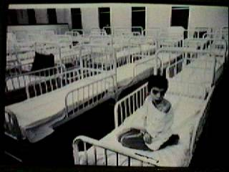
Human Subjects in Research The Willowbrook Study
New York institution for “mentally defective” children with a reputation for providing quality care.
From 1963-1966 a study was conducted to gain an understanding of the natural history of infectious hepatitis.
Newly admitted children were
deliberately infected.
Willowbrook closed its doors,
however, the hepatitis study continued for several more years.

Slide 36
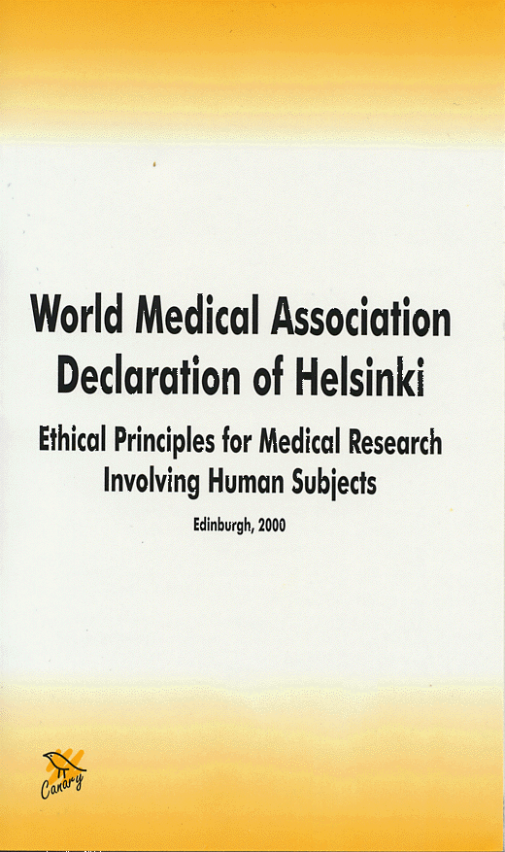
Human Subjects in Research Declaration of Helsinki
1964 (revised October 2002)
Distinguished between therapeutic activities and non-therapeutic research
Informed consent was the central requirement
It allowed (for the 1st time) surrogate consent for the
Physically incapacitated,
Mentally incapacitated and
Children.

Slide 37
Human Subjects in Research Federal Protections Began
National Research Act of 1974
It codify policy for the protection of human subjects (45 CFR 46).
Established Institutional Review Board as authorizing body for human subjects research.
Formed National Commission for the Protection of Human Subjects of Biomedical and Behavioral Research.
Only applied to federally funded or FDA regulated research.

Slide 38
Human Subjects in Research Belmont Report
“Ethical Principles and Guidelines for the Protection of Human Subjects” was published in 1979 by the U.S. DHEW.
The report listed three ethical principles upon which federal regulations would be based:
Respect for Persons
Beneficence
Justice

Slide 39
Human Subjects in Research Belmont Report: Cornerstone of Ethical Principals
Respect for Persons – People should be given all necessary information to make truly informed decisions.
Beneficence – Maximizing benefits while minimizing harm.
Justice – Treat all people as equals.

Slide 40
Human Subjects in Research Timeline of Response
National Research Act passed in 1974!
From NIH – Human Participant Protections Education for Research Teams

Slide 41
Recent Case: Jesse Gelsinger
Jesse had Ornithine Transcarbamylase (OTC) Deficiency of the liver – a condition that prevents the metabolism of ammonia. The disease is usually fatal at birth, but his condition was not inherited, rather it resulted from a genetic mutation after birth. He was able to survive on a restricted diet and medicine.
In September 1999, 18 year old Jesse volunteered in a gene therapy clinical trial at the University of Pennsylvania, Institute for Gene Therapy.
He was injected with an experimental adenoviral vector carrying a corrected gene.
He died four days later from a massive immune response resulting in multiple organ failure and brain death which was triggered by the vector.

Slide 42
Important information was withheld from Jesse and his family!
The lead doctor treating Jesse was also PI of the study.
He held one-third of the shares in the company that was developing the drug.
The company was funding the clinical trial at the University and
The University also held equity in the company!
Anything about this trouble you? Your thoughts?

Slide 43
Each of the primary elements of a serious conflict of interest was present!
The lead doctor treating Jesse was also PI of the study. (Conflicting clinical and research roles)
He held one-third of the shares in the company that was developing the drug. (Personal financial conflict of interest)
The company was funding the clinical trial at the University. (Financial interest could be viewed as compromising the scientific integrity of study) and
The University also held equity in the company! (Institutional conflict of interest)

Slide 44
Recent Case: Ellen Roche
Two Johns Hopkins University asthma researchers hypothesized that in people without asthma, lung inflation protects airways from obstruction through some unknown neural messaging mechanism and that this mechanism is somehow disabled in asthmatics.
They designed a clinical study to test their hypothesis and got approval from the appropriate IRB.
Their study design involved administering methacholine (a substance that mimics the symptoms of asthma) to healthy individuals.

Slide 45
Recent Case: Ellen Roche
A group of participants would subsequently be given a dose of hexamethonium, a ganglionic blocker that would prevent one of these neural messaging mechanisms from functioning.
Ellen, a 24 year old employee at the Asthma and Allergy Center responded to a flier and signed a “Clinical Investigation Consent Form” which did not include all relevant information on the risks involved with inhaling hexamethonium.
Ellen was either motivated by altruistic desires to help people with asthma or by the $365 fee!

Slide 46
Recent Case: Ellen Roche
On May 4, 2001 she received 1g of hexamethonium by inhalation, developed a dry cough the next day and by May 9 she was hospitalized with fever, hypoxia and various chest abnormalities. Her conditioned worsened and on June 2, 2001 she died of progressive hypotension and massive organ failure.
What’s wrong here? Your thoughts?
Let’s analyze this case using the three principles from the Belmont Report

Slide 47
Human Subjects in Research Belmont Report: Cornerstone of Ethical Principals
Respect for Persons – People should be given all necessary information to make truly informed decisions.
Was this principle followed? If not, how was the principle violated?

Slide 48
Human Subjects in Research Belmont Report: Cornerstone of Ethical Principals
Beneficence – Maximizing benefits while minimizing harm.
Was this principle followed? If not, how was the principle violated?

Slide 49
Human Subjects in Research Belmont Report: Cornerstone of Ethical Principals
Justice – Treat all people as equals.
Was this principle followed? If not, how was the principle violated?

Slide 50
The Investigation: Three agencies conducted investigations
Federal Food and Drug Administration (FDA)
Found five violations including failure to: submit Investigational New Drug application for the use of hexamethonium as an inhalant; report adverse effects from the experience of the earlier subject; and advise participants that use of drug was experimental.

Slide 51
The Investigation: Three agencies conducted investigations
Johns Hopkins University Internal Review
Criticized both the investigators and the IRB for failure to obtain FDA approval to use hexamethonium as an inhalant and ignoring respiratory problems experienced by the first participant.

Slide 52
The Investigation: Three agencies conducted investigations
Office of Human Research Protection (OHRP)
Harshest criticism of the three reports! They suspended all research using human subjects pending full compliance by Johns Hopkins.
Found “widespread noncompliance to federal guidelines of research involving human subjects.”
Stopped $301 million in federal research projects involving 2,400 investigators.
University came into compliance in 3 days.
Reached an out-of-court financial settlement with Ellen Roche’s family.

Slide 53
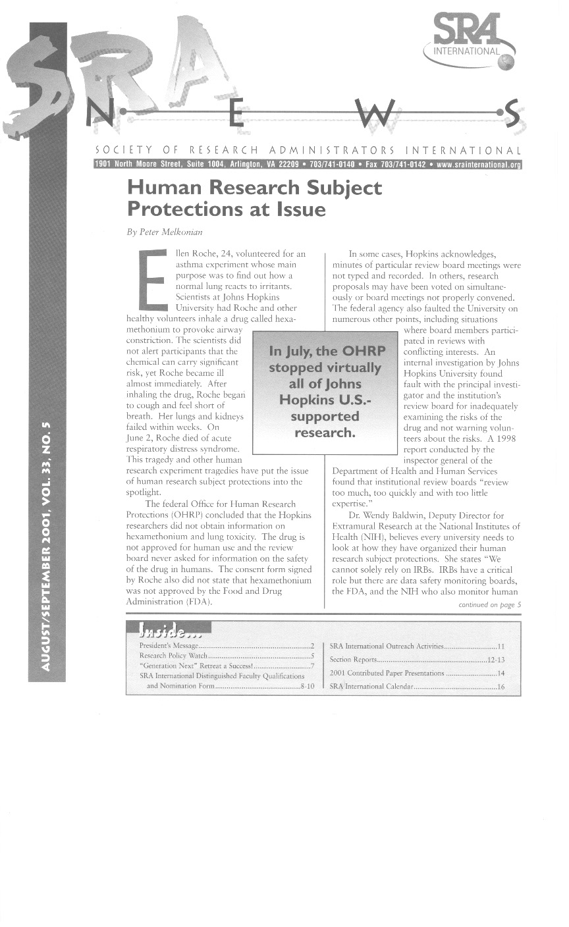

Slide 54
Selected Cases:
Duke University – Allegations of wide-spread noncompliance.
NIH – Children enrolled in a study involving “greater than minimal risk.”
Fred Hutchinson Cancer Center – Allegations of significant conflict of interest.

Slide 55
Why do these problems persist?
Financial pressures to obtain/keep research funding
The rise of corporate-sponsored research
Conflicts of Interests – both personal and institutional
!
Science without Ethics Can Lead to Abuse!

Slide 56
Human Subjects in Research
“The first two questions the IRB faces is whether the activity involves research and second, whether it involves human subjects.”
Office for Research Protections, DHHS IRB Review Book
What constitutes research?
What is a human subject?
The answers may seem obvious, but we must carefully define each of these terms.

Slide 57
“Research is defined by the regulations as a systematic investigation, including research development, testing and evaluation, designed to develop or contribute to generalizable knowledge.”
“Human subjects are defined by the regulations as living individual(s) about whom an investigator (whether professional or student) conducting research obtains (1) data through intervention or interaction with the individual, or (2) with identifiable private information.”
Office for Research Protections, DHHS IRB Review Book

Slide 58
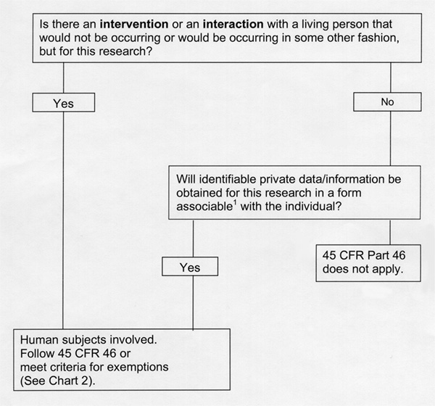
Is it human subject research?
Notes:
DOES THIS APPLY TO VR research?
YES—an interaction that wouldn’t be happening without study
More intersting, is this a clinical trial? Defn of clinical trial includes “behavioral intervention” studies, and our NIH program officers have decided that we do fall in this category. (Means we have to do additional work defining a Safety monitoring plan, including procedures for reporting adverse effects of the study) WHAT PROMPTED THIS? The Hopkins incident…

Slide 59
Examples of studies with humans that require IRB review?
Clinical trial of investigational drug
Comparison of educational methodologies
New virtual reality program - testing undergraduate students wearing headgear
Chart review of patient data with no patient contact
Quality of life study of community housing residents
Venous blood samples from volunteers

Slide 60
Examples of studies with humans exempt from IRB review
Educational (classroom) strategies
Use of educational tests
(Re) study of existing data with no
identification of participants
Study or evaluation of public benefit
programs
Taste and food quality evaluation
(if consumption is otherwise safe)

Slide 61
Best Practice: Always submit to the IRB and let them determine if approval is required!
Better to be safe than sorry!
Notes:
SUMMARIZE:
Subject to regulations if: systematic collection of information to add to general knowledge
Use living humans
Not exempt

Slide 62
Informed Consent
Information: Informed consent must provide clear information regarding the research study, location, procedures to be followed, potential risks, possible benefits, duration of the study, alternatives, confidentiality provisions, contact information, and assurance of freedom to withdraw without penalty.

Slide 63
Informed Consent
Comprehension: Informed consent must be obtained in a way that is intelligent, rational and respective of the maturity of enrollees. Consent documents must be written in the native language of enrollees, and in a way that is non-technical/non-scientific. The informed consent process and informed consent forms are not for the benefit of the scientist or the lawyers!

Slide 64
Informed Consent
Voluntariness: Informed consent must preclude any element or even the appearance of coercion or undue influence.

Slide 65
Institutional Review Boards (IRB’s)
Institution-based
Peer review
Prior review, approval and/or modification

Slide 66
Care and Use of Animals in Research Public Involvement
1962 – Silent Spring, by Rachel Carson
1966 – LIFE magazine article

Slide 67
Care and Use of Animals in Research Public Involvement
1969 – Greenpeace founded
1975 – Animal Liberation, by Peter Singer
1982 – “Silver Spring Monkeys”
“Infiltration” of lab by obtaining “visitor” affidavits
Photos and affidavits
Search warrant and seizure
First-ever criminal conviction of a US researcher on animal cruelty charges
PETA on the map

Slide 68
In 2002, PETA infiltrated UNC labs and documented problems with the procedure for killing mice!

Slide 69
Care and Use of Animals in Research Government Involvement
1962 – NIH issued the first Guide For the Care and Use of Laboratory Animals
1966 – Laboratory Animal Welfare Act
Covered warm blooded animals used in teaching, research and testing
Excluded rats, mice and birds
Enforced by the USDA
Annual Inspections were required

Slide 70
Care and Use of Animals in Research Government Involvement
1970 – Animal Welfare Act
(updated in 1976, 1985, 1990)
1973 – Public Health Service Policy
(updated in 1979, 1985)
1985 – PHS Health Research Extension Act
Covered live vertebrate animals when PHS funds are involved.
Enforced by the Office of Laboratory Animal Welfare (OLAW), NIH.

Slide 71
Care and Use of Animals in Research Government Involvement
Both PHS Policy and the AWA established the Institutional Animal Care and Use Committee (IACUC) as the authorizing body
Membership
Representative of entire institution
One non-scientist
Community representative out-side of university
Review proposed studies
Report

